Slide 1


Online Quiz App: Empowering Knowledge and Engagement
by S V RUCHITHA .

Slide 2
Why an Online Quiz App?
Accessible Learning
Interactive Engagement
Online quizzes are readily available anywhere with an internet connection, removing barriers to access.
Quizzes provide an engaging way to learn, making the process more enjoyable and memorable.

Slide 3
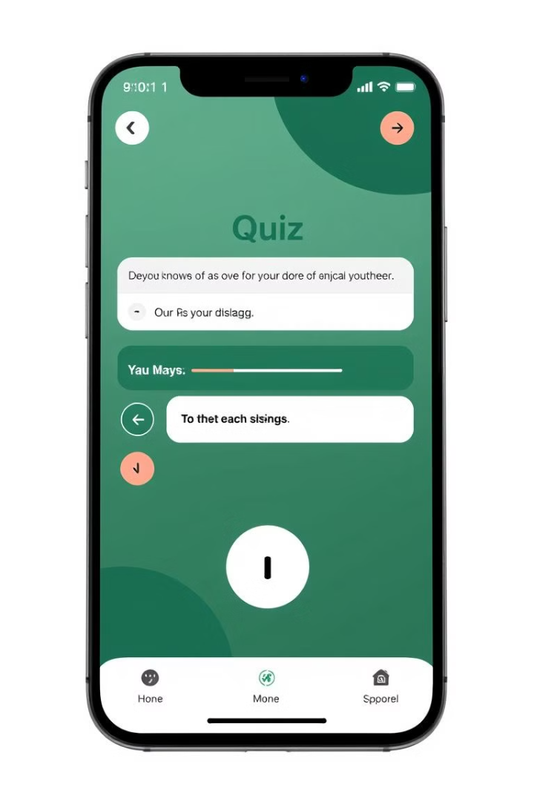
Key Features of Our Quiz App
1
Adaptive Difficulty
2
Detailed Feedback
The app adjusts to each user's skill level, making learning more effective and tailored to individual needs.
Quizzes provide instant feedback on correct and incorrect answers, enabling users to identify areas for improvement.
3
Progress Tracking
The app tracks user progress, allowing them to monitor their development and celebrate their achievements.

Slide 4




Gamifying the Learning Experience
Points and Rewards
Leaderboards
Badges and Achievements
Users earn points and rewards for completing quizzes, motivating them to continue learning.
Leaderboards encourage healthy competition and motivate users to strive for higher scores.
Users receive badges for completing specific milestones, celebrating their progress and dedication.

Slide 5
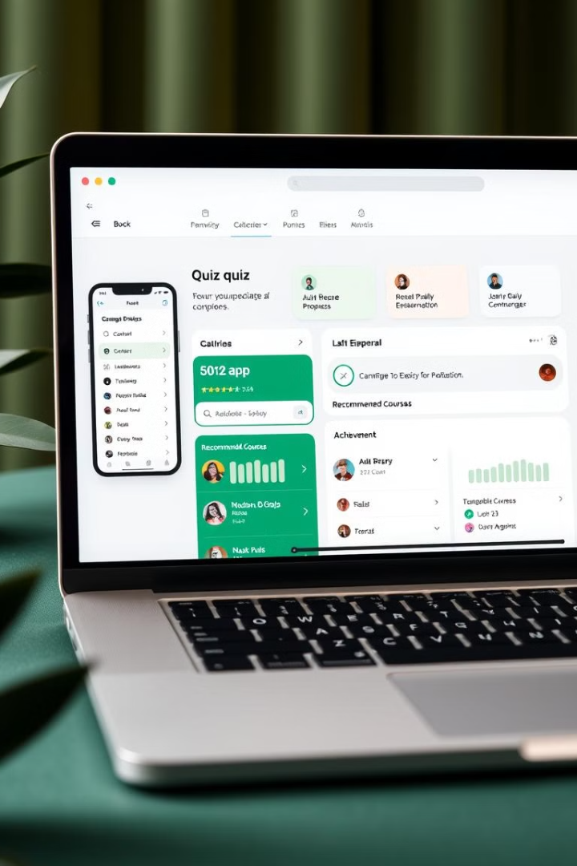
Personalized Learning Pathways
Personalized Recommendations
The app analyzes user performance and suggests customized learning paths based on their strengths and weaknesses.
Targeted Content
The app delivers targeted content relevant to the user's specific learning goals and interests.
Individualized Feedback
The app provides personalized feedback tailored to each user's learning style and needs, fostering deeper understanding.

Slide 6




Fostering Healthy Competition
Social Sharing
Collaborative Learning
Group Challenges
Users can share their quiz scores and achievements with friends, sparking friendly competition and encouraging learning.
The app facilitates collaborative learning by allowing users to engage with each other and discuss quiz questions.
The app provides a platform for group challenges, fostering team spirit and motivation.

Slide 7

Promoting Digital Literacy in Society
1M
1B
Access
Empowerment
The app provides equal access to learning for all, breaking down barriers and fostering a more inclusive society.
The app equips individuals with the digital skills necessary to thrive in a rapidly evolving world.
1T
Innovation
The app inspires innovation and creativity by providing a platform for users to explore new ideas and knowledge.

Slide 8



Conclusion: The Future of Interactive Education
Engaging
1
Our quiz app brings a fun and engaging way to learn.
Personalized
2
It caters to individual learning styles and paces.
Accessible
3
It breaks down barriers and empowers learners.

